Slide 1

Web Development
Internet Creativity

Slide 2

What is Web Development and Why Do We Care?
Creating Websites and Web Applications
Let your creativity shine
Tell the world all about you

Slide 3
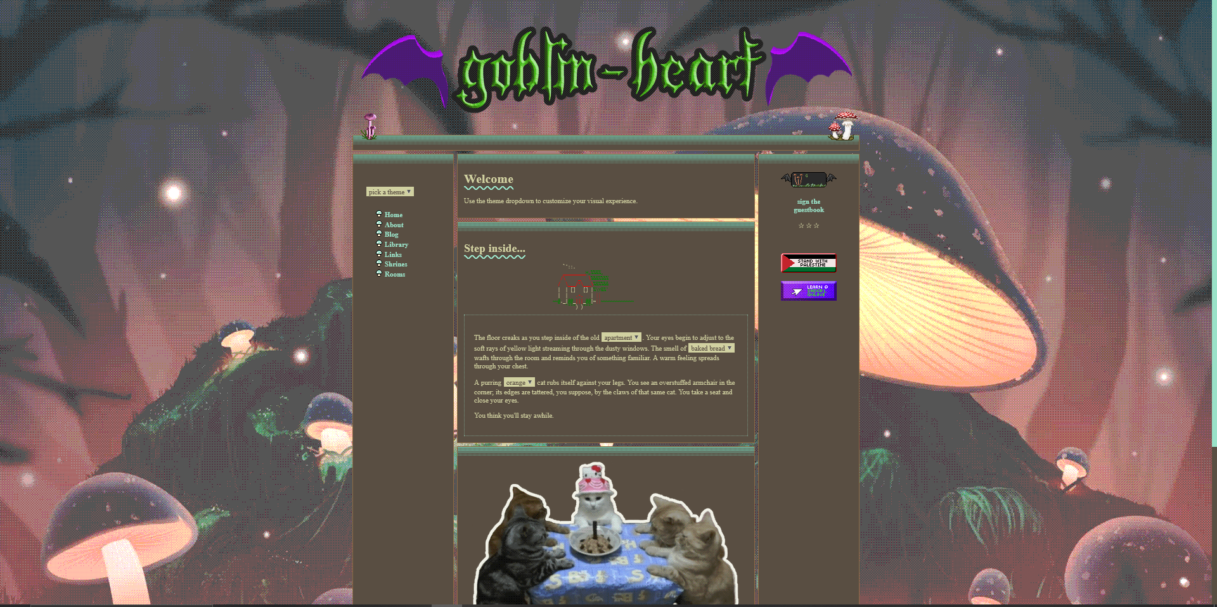

Slide 4
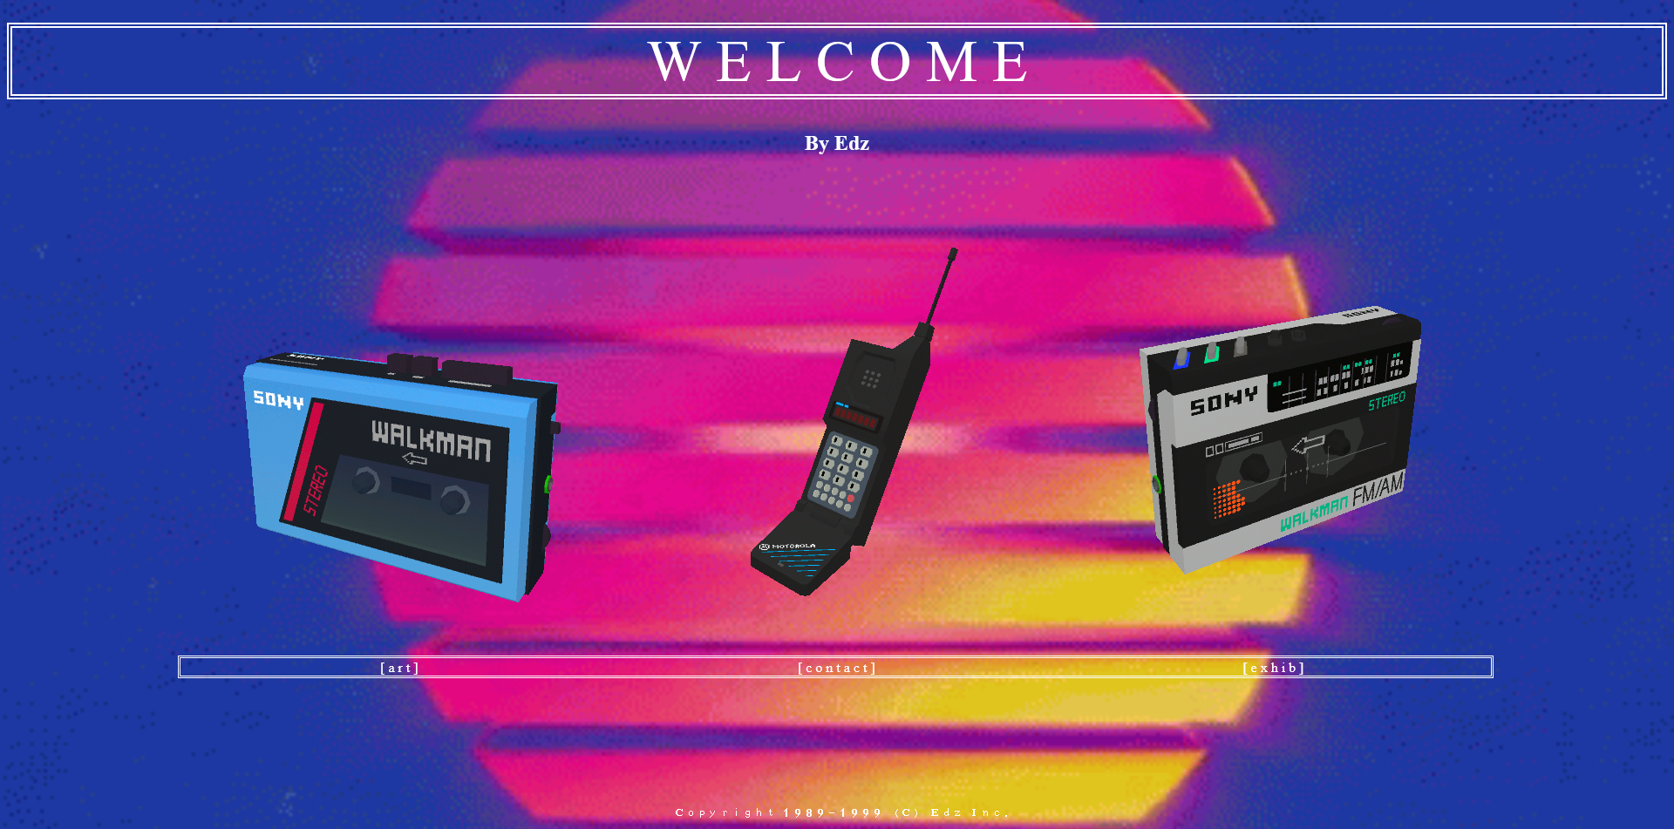

Slide 5
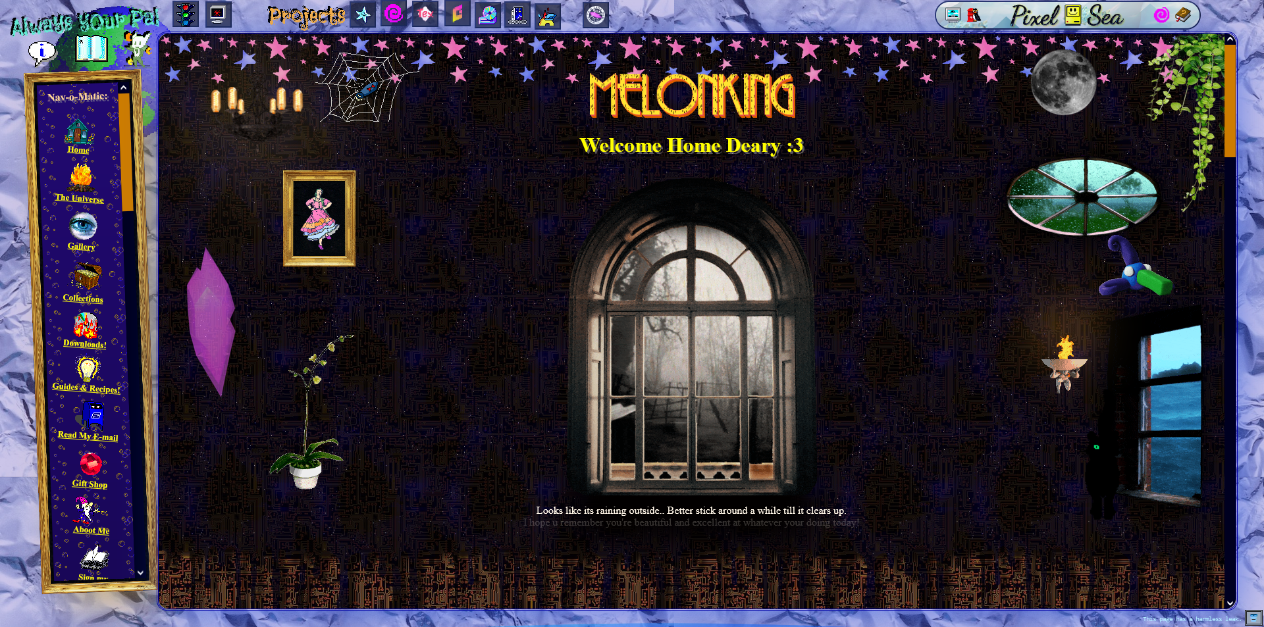

Slide 6




Web Development is like Building a House
HTML is like the bricks
CSS is like paint
JavaScript is like wiring

Slide 7
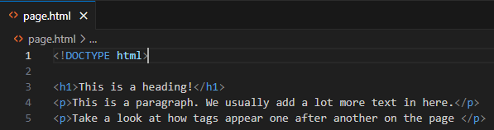
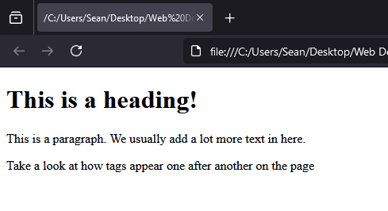
HTML Basics
HTML- Hypertext Markup Language
Every document starts with:
<!DOCTYPE html>
Built out of tags
E.g. <p></p>
Content is placed inside these tags

Slide 8
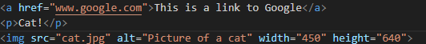
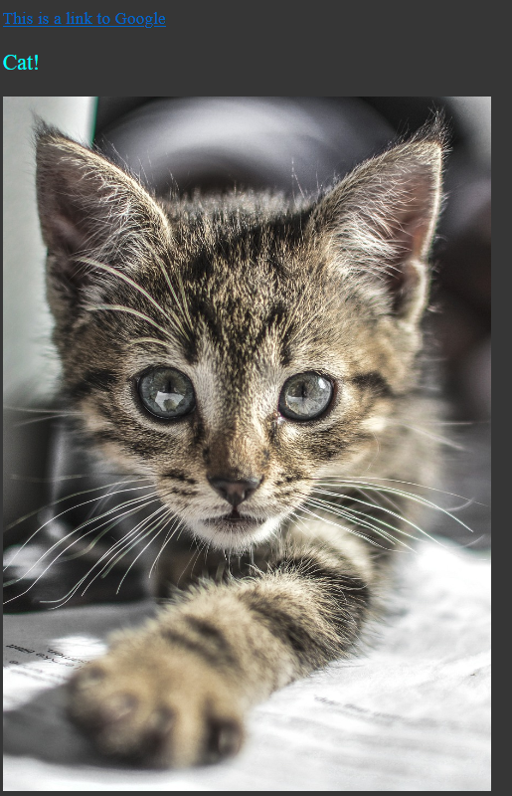
HTML Basics
Some more useful tags:
<a> tag – Links to other pages
<img> tag – Embeds an image to the page
<video> tag – Embeds a video to the page

Slide 9
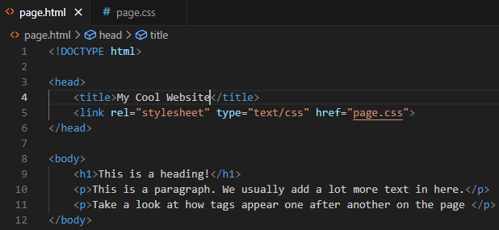
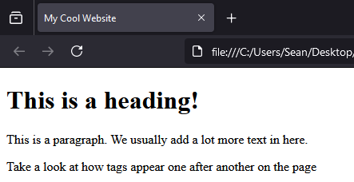
Connecting CSS
We use HTML <head> and <body> tags
The <head> tag contains page “metadata” – Aka important information
We use the <link> tag, tell it the type is a CSS stylesheet, and give it the file location
The <body> tag contains the page content

Slide 10
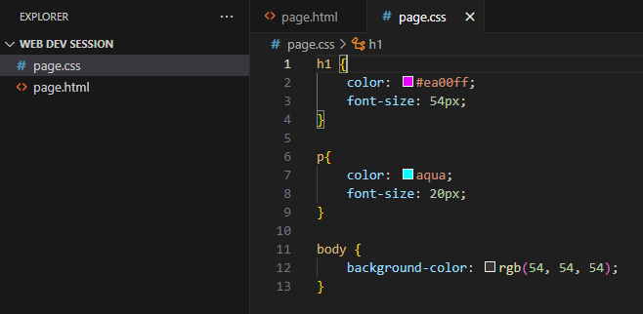
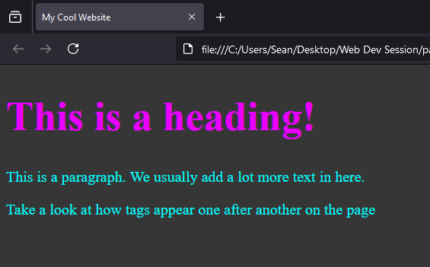
CSS Basics
CSS - Cascading Style Sheets
We use “Selectors” to tell the code what we want to change
E.g. h1, p, body
We use CSS’s in-built rules to change aspects of the website to look how we want

Slide 11
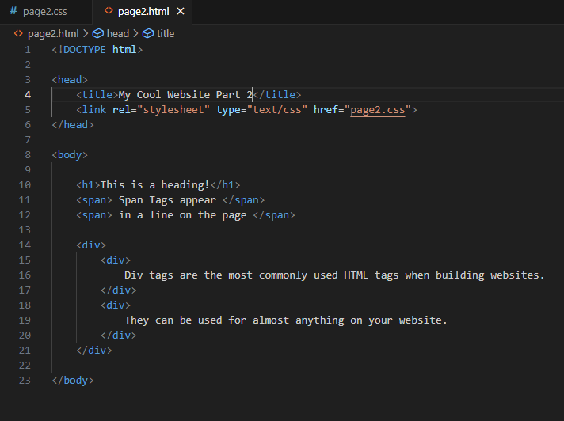
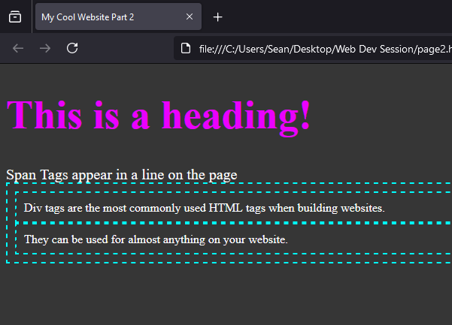
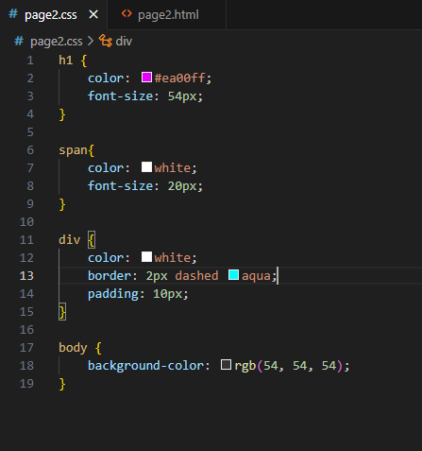
Divs, Spans, and Nesting

Slide 12
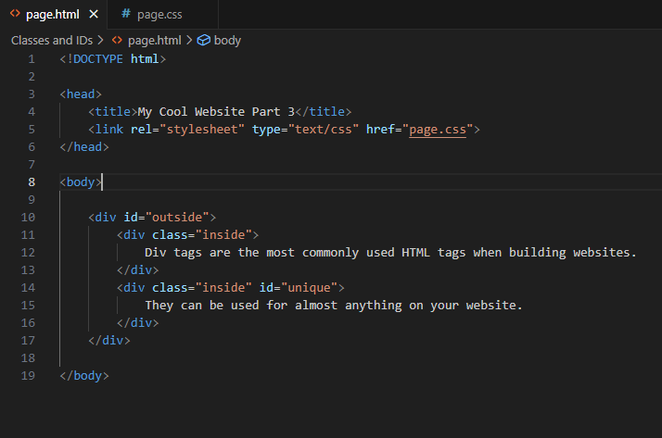
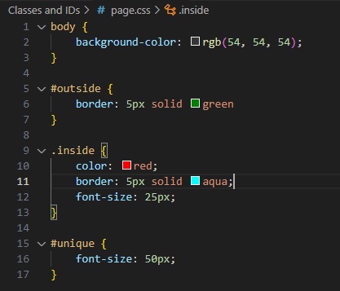
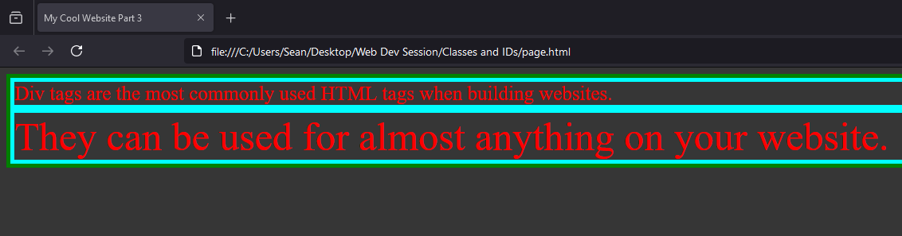
Class Names and IDs

Slide 13
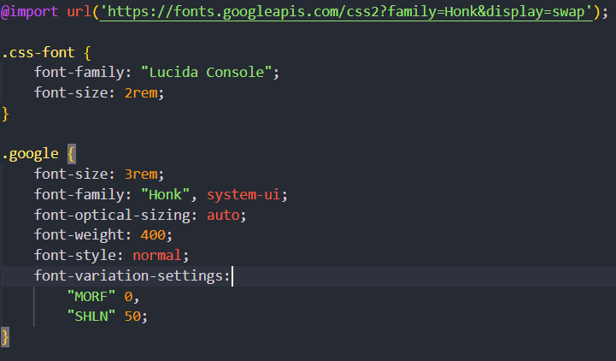
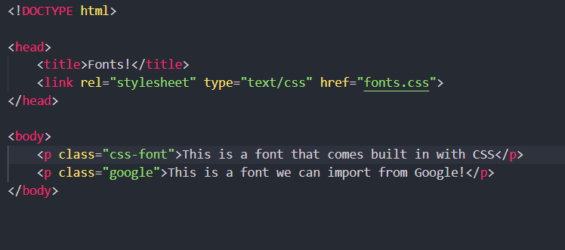
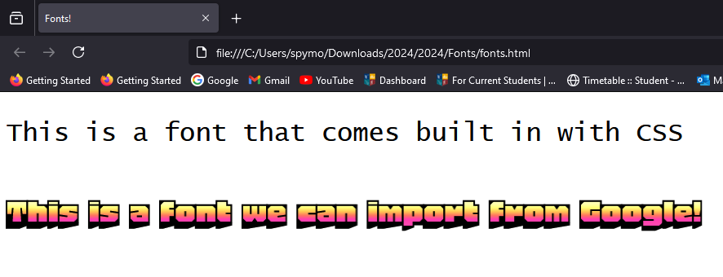
Changing Fonts

Slide 14
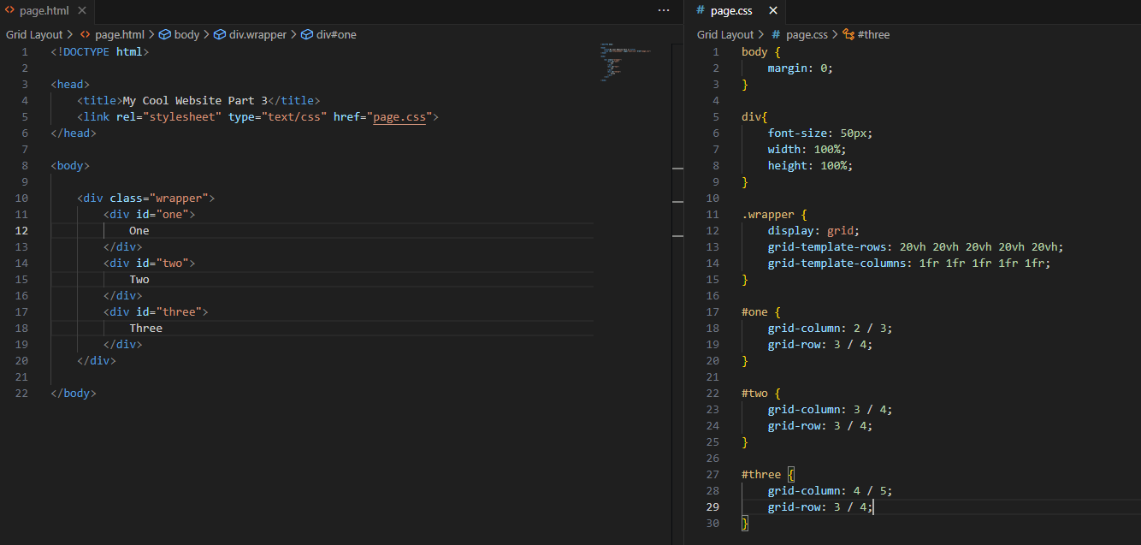
Organizing Things – Grid Layout

Slide 15
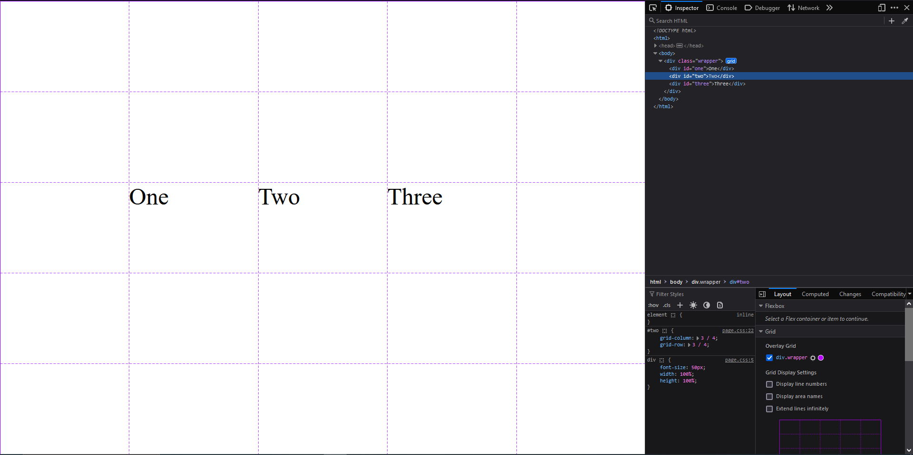
Organizing Things – Grid Layout

Slide 16
Finally - Get Creative!
Start with the basics – Make a simple HTML webpage.
Use the grid template provided so you can easily place anything wherever you want on the screen
Then add styles – Colours, images, whatever you want – Make it Personal!
I’ve added a folder with some extra HTML and CSS that you can add to your website
If you are stuck on anything, ask for help!
As an extra challenge, try see if you can add some JavaScript!

